Slide 1

Statsjam: General Linear Model vs Generalized Linear Model
2022. Oct. 03
Bzdok lab

Slide 2
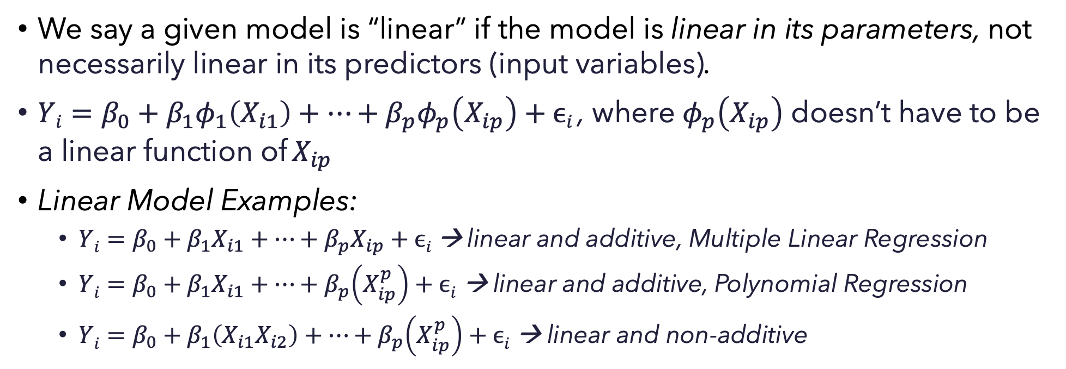
Recap of Last week on Linearity and Additivity
We say a given model is “linear” if the model is linear in its parameters, not necessarily linear in its predictors (input variables).
$Yi=β_{0}+β_{1}φ_{1}\left(X_{i1}\right)+…+β_{p}φ_{p}\left(X_{ip}\right)+ϵi$, where $φ_{p}\left(X_{ip}\right)$ doesn’t have to be a linear function of $X_{ip}$
Linear Model Examples:
$Yi=β_{0}+β_{1}X_{i1}+…+β_{p}X_{ip}+ϵi$ → linear and additive, Multiple Linear Regression
$Yi=β_{0}+β_{1}X_{i1}+…+β_{p}\left(X_{ip}^{p}\right)+ϵi$ → linear and additive, Polynomial Regression
$Yi=β_{0}+β_{1}\left(X_{i1}X_{i2}\right)+…+β_{p}\left(X_{ip}^{p}\right)+ϵi$ → linear and non-additive
Notes:
The following three are all linear in parameters
the first is linear in parameters, linear in predictors
the second one is linear in parameters, but not linear in predictors.
The first two are additive, because each predictor has separate impact on the outcome Yi
The third one is linear in parameters, not linear in predictors, and Non-additive because Xi1 and Xi2 have a joint impact on Yi, not separately.

Slide 3
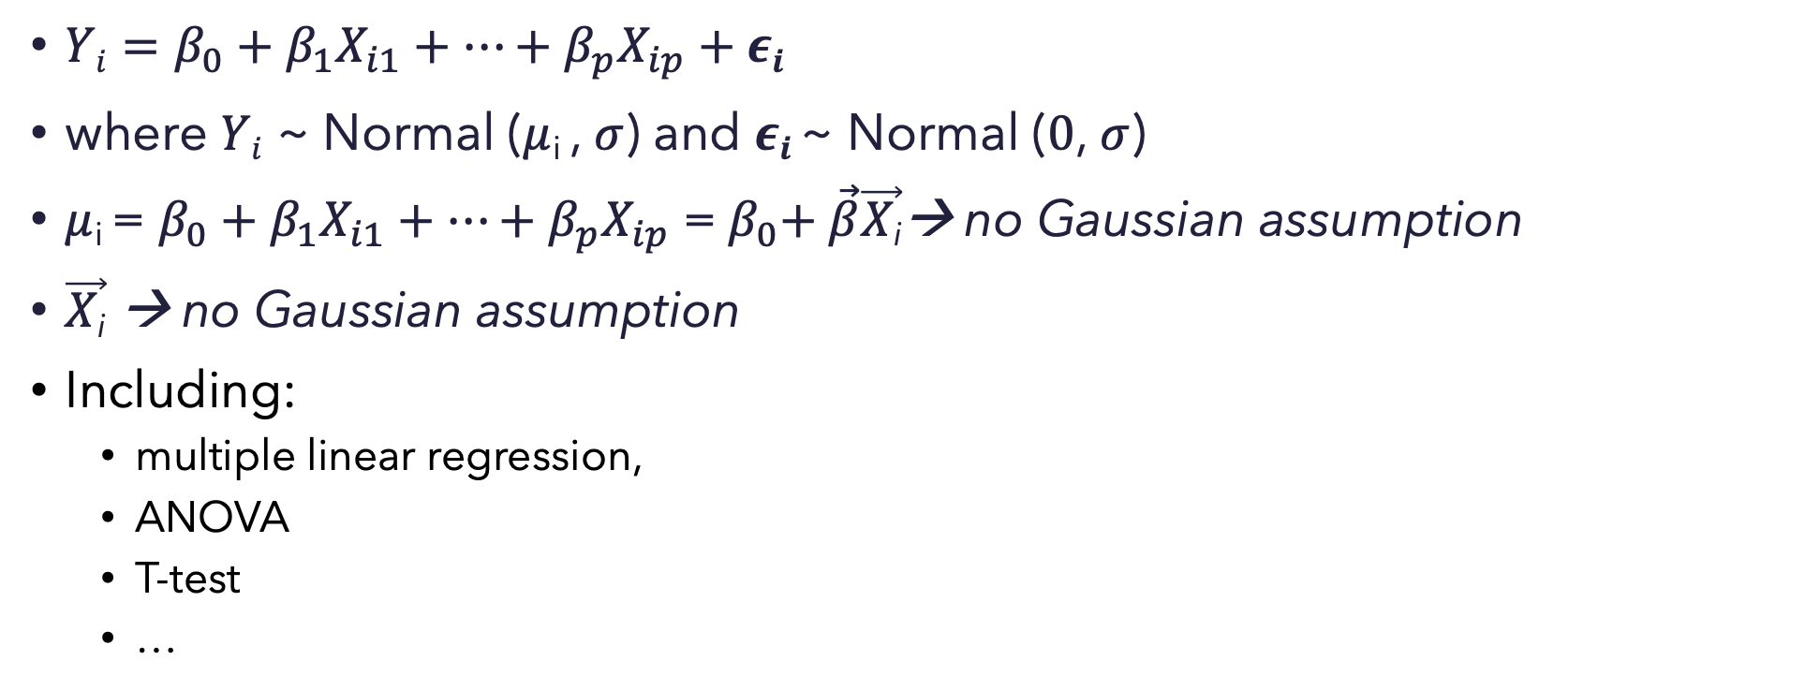
General Linear Model – Gaussian assumption!
$Yi=β_{0}+β_{1}X_{i1}+…+β_{p}X_{ip}+εi$
where $Yi$ ~ Normal ($μ$_{i} , $σ$) and $εi$ ~ Normal ($0$, $σ$)
$μ$_{i} = $β_{0}+β_{1}X_{i1}+…+β_{p}X_{ip}$ =${ β}_{0}+ \vec{β}\vec{X\text{i}}$→ no Gaussian assumption
$\vec{X\text{i}}$ → no Gaussian assumption
Including:
multiple linear regression,
ANOVA
T-test
…
Notes:
the form of a general linear model is basically what we have for a classic linear regression model.
The most important thing is that we Impose Gaussian assumption on the model.
Outcome Yi is normally distributed with a mean miu and a variance sigma, and regression errors epsilon normally distributed with 0 and sigma. Therefore the gaussian assumption on Yi comes from the gaussian assumption on 𝑒𝑝𝑠𝑖𝑙𝑜𝑛,
finally we don't impose any gaussian assumptions on on the raw outcome miu, nor on the predictors.
$−→ Althoguh we assume Gaussian distribution on the error term, the σ$ sigma can’t be modeled explicitly.

Slide 4
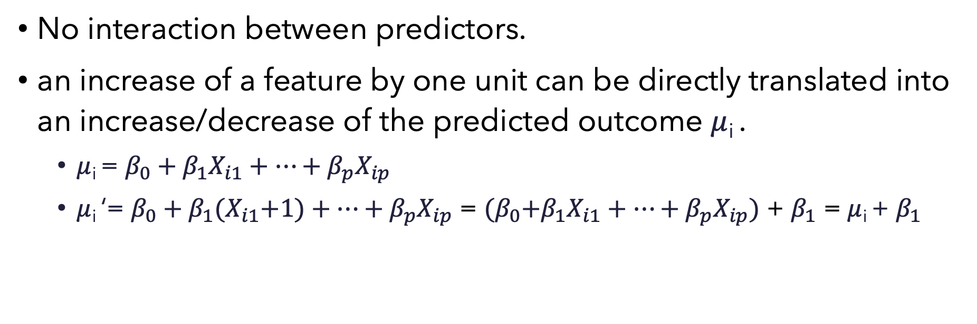
Strict additivity and linearity
No interaction between predictors.
an increase of a feature by one unit can be directly translated into an increase/decrease of the predicted outcome $μ$_{i} .
$μ$_{i} = $β_{0}+β_{1}X_{i1}+…+β_{p}X_{ip}$
$μ$_{i} ‘= $β_{0}+β_{1}{(X}_{i1}+1)+…+β_{p}X_{ip}$ = ${(β}_{0}+β_{1}X_{i1}+…+β_{p}X_{ip})$ + $β_{1}$ = $μ$_{i} + $β_{1}$

Slide 5
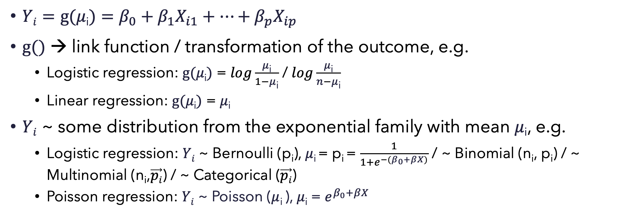
Generalized Linear Model (GizedLM)
$Yi=g(μ\text{i})=β_{0}+β_{1}X_{i1}+…+β_{p}X_{ip}$
$g()$ → link function / transformation of the outcome, e.g.
Logistic regression: $g(μ\text{i})$ = $log\frac{μ\text{i}}{1−μ\text{i}}$ / $log\frac{μ\text{i}}{n−μ\text{i}}$
Linear regression: $g(μ\text{i})$ = $μ\text{i}$
$Yi$ ~ some distribution from the exponential family with mean $μ\text{i}$, e.g.
Logistic regression: $Yi$ ~ Bernoulli (p_{i}), $μ\text{i}$= p_{i} = $\frac{1}{1+e^{−(β_{0}+βX)}}$ / ~ Binomial (n_{i}, p_{i}) / ~ Multinomial (n_{i},$\vec{pi}$) / ~ Categorical ($\vec{pi}$)
Poisson regression: $Yi$ ~ Poisson ($μ$_{i} ), $μ\text{i}$ = $e^{β_{0}+βX }$
Notes:
Generalized Linear Model: an extension of the general linear model that allows the models response variable Yi to follow different distributions, and relate the distribution to the linear predictors by using a link function.
Here Generalized Linear Model models the mean of that distribution we associate the outcome Yi with, not modeling the individual outcome value, so we don’t have the error term.
General Linear Model can be viewed as a special case of Generalized Linear Model, with identity link function and normal-distributed outcomes.

Slide 6
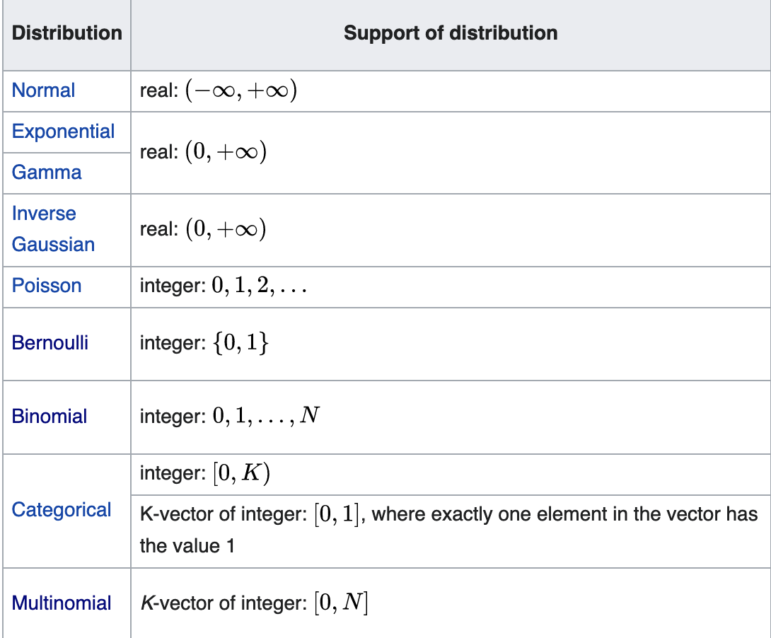
Exponential family
Floor and ceiling effect
Notes:
This is actually an extended exponential family, and why do we use exponential family? Because they are common and the calculation for parameters are easy!
if a distribution belongs to exponential family, maximum likelihood estimation and inference are greatly simplified and can be handled in a unified framework
Compared to general linear models where the range of Yi is indefinite, Generalized Linear Models have boundaries, so that we can model some data types that are constrained to a range. Maybe the data should always be positive, or the data is categorical so on and so forth.

Slide 7
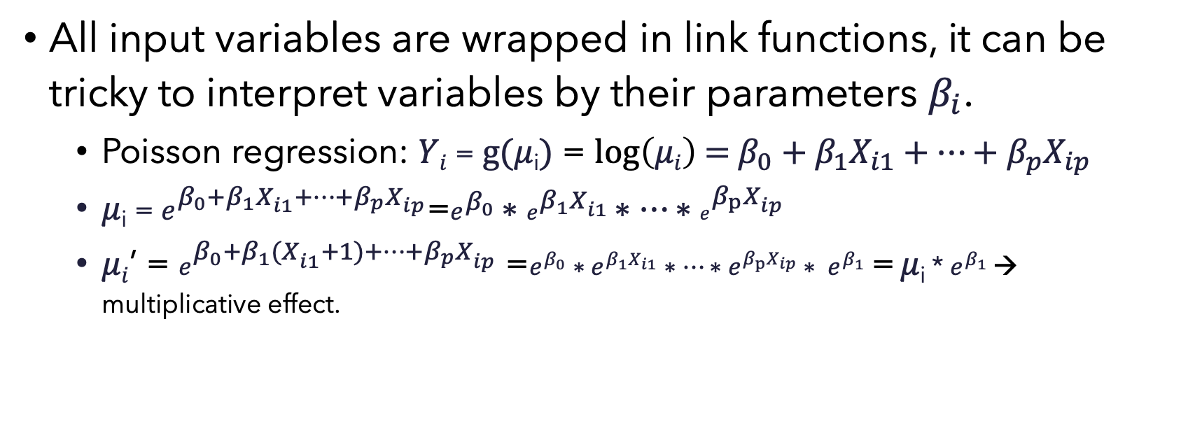
Loss of strict additivity and linearity
All input variables are wrapped in link functions, it can be tricky to interpret variables by their parameters $β_{i}$.
Poisson regression: $Yi$ =$g(μ\text{i})$ = $\log\left(μi\right)$ = $β_{0}+β_{1}X_{i1}+…+β_{p}X_{ip}$
$μ\text{i}$ = $e^{β_{0}+β_{1}X_{i1}+…+β_{p}X_{ip}}$=$e^{β_{0}}∗e^{β_{1}X_{i1}}∗…∗e^{β_{p}X_{ip}}$
$μi$’ = $e^{β_{0}+β_{1}{(X}_{i1}+1)+…+β_{p}X_{ip}}$ =$e^{β_{0}}∗e^{β_{1}X_{i1}}∗…∗e^{β_{p}X_{ip}}∗ e^{β_{1}}$ = $μ\text{i}$ * $e^{β_{1}}$ → multiplicative effect.
Notes:
The above example is friendly, but there are cases mixed of both multiplicative and additive effects

Slide 8
Common Extensions of GizedLM
Generalized additive model (GAM)
Generalized linear mixed model (GLMM)

